Slide 1
Beyond Sunlight: An Aquatic Chemosynthetic World
Project “Hello Ocean”
NASA Space Apps 2024 Challenge
Team Members:
Baris Gunay
Ismail Kaan Sonmez

Slide 2
1. Problem Statement
This challenge explores how life can thrive in environments without sunlight, particularly through chemosynthesis, where organisms rely on chemical energy instead of photosynthesis.
Studies suggest that hydrothermal vents, like those found on Earth's ocean floor, could serve as energy sources for life in environments without sunlight, such as the subsurface oceans on icy moons like Enceladus and Europa. On Earth, chemosynthetic organisms thrive in deep-sea environments by converting chemical compounds like hydrogen sulfide into energy, a process independent of sunlight [1], [2].
Our objective is to simulate the interactions of life forms (autotrophic and heterotrophic bacteria) in a chemosynthetic ecosystem fueled by hydrothermal vents.

Slide 3
2. Scientific Background
Chemosynthesis: Life forms like bacteria can thrive by converting chemical energy from inorganic compounds such as hydrogen sulfide (H₂S) into organic compounds, without needing sunlight. This process is key to life in deep-sea environments on Earth and could also sustain life on other ocean worlds [1], [2].
Hydrothermal Vents: Hydrothermal vents on moons like Europa and Enceladus release chemicals that could serve as energy sources for chemosynthetic organisms, similar to Earth’s deep-sea ecosystems [1].
Life Forms in the Simulation:
Autotrophs: Organisms that produce their own energy using chemical reactions.
Heterotrophs: Organisms that consume autotrophs or other organic material for energy.

Slide 4
3. Simulation Design
We designed a 2D virtual ocean world with a grid that tracks chemical concentrations, and the coordinates of autotrophs and heterotrophs.
Key Features:
Hydrothermal vents are placed randomly to release chemicals.
Life forms wander around the grid to find food.
Autotrophs consume these chemicals and reproduce, while heterotrophs consume autotrophs.
Chemical diffusion simulates the spread of energy sources.
Visualization: The simulation displays chemical concentration and organism distribution (autotrophs and heterotrophs) on heatmaps.

Slide 5
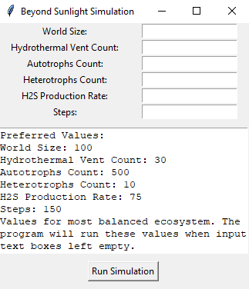
4. Technical Implementation with Python
Important classes include:
OceanWorld: Manages the chemical grid and lifeform interactions.
HydrothermalVent: Releases chemical energy.
Autotroph and Heterotroph: Represent life forms that either metabolize chemical energy or consume other organisms.
Key Processes:
Chemical Diffusion: The simulation uses a diffusion model to spread chemical concentrations across the grid, allowing autotrophs to access energy.
Lifeform Behavior: Autotrophs metabolize chemicals from the environment, gaining energy and reproducing under favorable conditions, while heterotrophs consume autotrophs to survive and reproduce.
UI for experimenting with simulation parameters

Slide 6
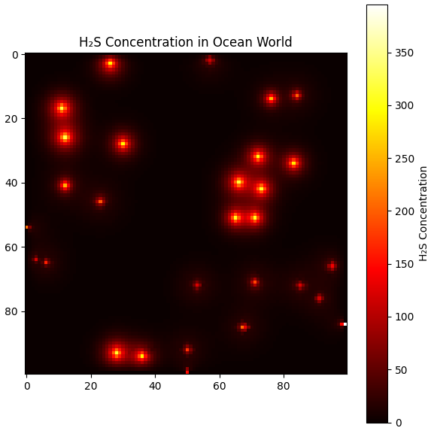
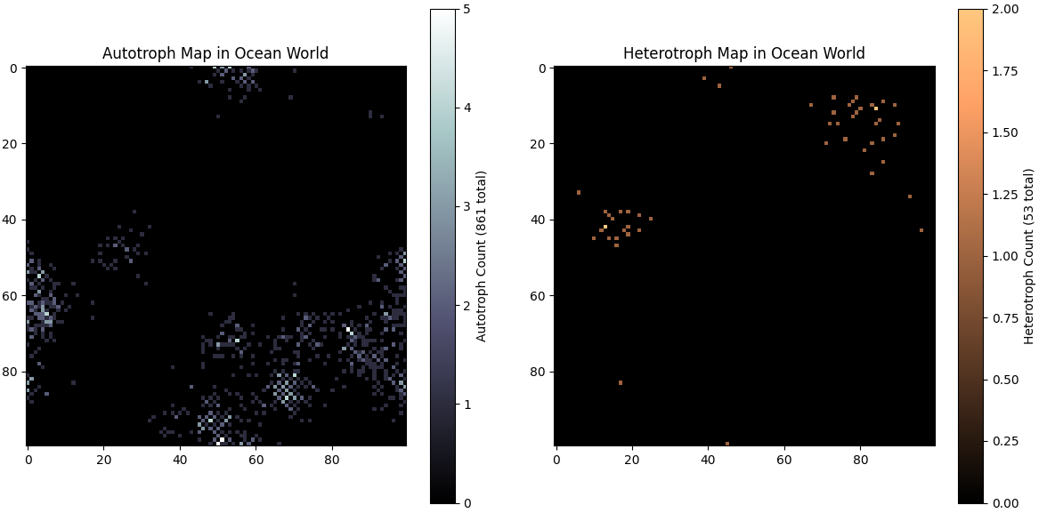
5. Results
Results of a simulation can be seen in the graphs. Notice how autotrophs cluster around hydrothermal vents, while heterotrophs cluster around autotrophs.
The simulation demonstrates how chemosynthetic life forms can thrive in an ocean world without sunlight.
Key Findings:
Autotrophs survive and reproduce as long as chemical concentrations from hydrothermal vents are sufficient.
Heterotrophs rely on autotrophs for survival, creating a balanced ecosystem.

Slide 7
6. Conclusion, Future Work & References
Conclusion: Our simulation shows that, although much more difficult and unstable since the main energy sources are scattered around, chemosynthesis could sustain life in environments without sunlight, much like the conditions in ocean worlds such as Europa.
Future Work: The simulation can be further expanded with implementations such as a bigger ecosystem with different chemical sources, or even evolution-like behaviour using machine learning algorithms [3].
[1] C. Q. Choi, “Hydrothermal Vent Experiments Bring Enceladus to Earth,” Astrobiology at NASA, Dec. 2017. Available: https://astrobiology.nasa.gov/news/hydrothermal-vent-experiments-bring-enceladus-to-earth/
[2] NASA Science, “Life Signs Could Survive Near Surfaces of Enceladus and Europa,” NASA Science, Jul. 2024. Available: https://science.nasa.gov/science-research/planetary-science/astrobiology/nasa-life-signs-could-survive-near-surfaces-of-enceladus-and-europa/. [3] V. Da Poian, B. Theiling, L. Clough, B. McKinney, J. Major, J. Chen, and S. Hörst, "Exploratory data analysis (EDA) machine learning approaches for ocean world analog mass spectrometry," Frontiers in Astronomy and Space Sciences, vol. 10, no. 1134141, May 2023. DOI: 10.3389/fspas.2023.1134141.

